Slide 1




UBER TRIP ANALYSIS
Sunil Kumar Prusty

Slide 2
DAHBOARD 1: OVERVIEW ANALYSIS
"Analyze Uber trip data using Power BI to uncover insights into booking trends, revenue generation, and trip efficiency, enabling stakeholders to make informed, data-driven decisions.“
KPI’s
Total Bookings – How many trips were booked over a given period?
Total Bookings = COUNT('Trip Details'[Trip ID])
2. Total Booking Value – What is the total revenue generated from all bookings?
Total Booking Value = sum('Trip Details'[fare_amount])+ SUM('Trip Details'[Surge Fee])
3. Average Booking Value – What is the average revenue per booking?
Avg Booking Value = DIVIDE([Total Booking Value],[Total Bookings],BLANK())
4. Total Trip Distance – What is the total distance covered by all trips?
Total Trip Distance =
VAR TotalMiles = SUM('Trip Details'[trip_distance]) / 1000
RETURN
CONCATENATE(FORMAT(TotalMiles,"0"),"K Miles")
5. Average Trip Distance – How far are customers traveling on average per trip?
Average Trip Distance =
VAR AvgMile = ROUND(AVERAGE('Trip Details'[trip_distance]),0)
RETURN
CONCATENATE(AvgMile, " Miles")
6. Average Trip Time – What is the average duration of trips?
Average Trip Time =
VAR AvgTime = AVERAGEX('Trip Details',
DATEDIFF('Trip Details'[Pickup Time],'Trip Details'[Drop Off Time],MINUTE))
RETURN
CONCATENATE(FORMAT(AvgTime,"0"),"min")

Slide 3
Expected Outcomes:
✔ Identify trends in ride bookings and revenue generation. ✔ Analyse trip efficiency in terms of distance and duration. ✔ Compare booking values and trip patterns across different time periods. ✔ Provide insights to optimize pricing models and improve customer satisfaction
CHART’s
Create a Measure Selector using a Disconnected Table with the following values:
Total Bookings
Total Booking Value
Total Trip Distance
Then, use a measure to dynamically update the visualizations based on user selection.
By Payment Type (Card, Cash, Wallet, etc.)
By Trip Type (Day/Night)

Slide 4
Additional Enhancements:
Dynamic Title – Update the chart title based on the selected measure.
Slicers – Add filters for Date, City, and other interactive filters for deeper analysis.
Tooltips – Show additional details like Average Booking Value or Trip Distance.
Vehicle Type Analysis - Grid View in Power BI
Create a grid table (matrix or table visual) to analyse key performance indicators like Total Bookings, Total Booking Value, Avg Booking Value, Total Trip Distance across different Vehicle Types in Uber trips.
Power BI Implementation:
Use a Table or Matrix Visual to display Vehicle Type with the KPIs.
Apply Conditional Formatting to highlight high and low values.
Enable Sorting & Filtering for user interaction.
Total Bookings by Day
Detecting trends and fluctuations in daily trip volumes.
Identifying peak and off-peak booking days.
Understanding the impact of external factors (holidays, events, weather) on ride demand.
Supporting strategic planning for resource allocation and pricing adjustments.

Slide 5
Location Analysis
Understanding trip locations is crucial for optimizing ride distribution, demand forecasting, and operational efficiency. This analysis focuses on:
Most Frequent Pickup Point
Identify the most common starting locations for trips.
Helps in optimizing driver availability and dynamic pricing strategies.
To using the Dax measure
Most Frequent Pickup Point =
VAR PickPoint = TOPN(1,
SUMMARIZE('Trip Details', 'Location Table'[Location],
"Pickup Point",
COUNT('Trip Details'[Trip ID])
),
[Pickup Point],DESC)
RETURN
CONCATENATEX(PickPoint, 'Location Table'[Location],",")

Slide 6
Most Frequent Drop-off Point
Find the most common drop-off locations.
Requires activating an inactive relationship in Power BI between Pickup Location and Drop-off Location in the data model.
How to resolve the using DAX
Most Frequent Dropoff Point =
VAR DropOffCounts =
ADDCOLUMNS(
SUMMARIZE(
'Trip Details',
'Location Table'[Location] ),
"Drop Off Counts",
CALCULATE(
COUNT('Trip Details'[Trip ID]),
USERELATIONSHIP('Trip Details'[DOLocationID],'Location Table'[LocationID])))
VAR RankedDropOffs =
ADDCOLUMNS(
DropOffCounts,
"Rank",
RANKX(DropOffCounts,[Drop Off Counts],,DESC,Dense))
VAR TopDropOff = FILTER(RankedDropOffs,[Rank] = 1)
RETURN
CONCATENATEX(TopDropOff,'Location Table'[Location],",")

Slide 7
Farthest Trip
Determine the longest trip based on distance travelled.
Useful for analysing outlier trips, long-distance demand, and fare optimization.
Father Trip =
VAR MaxDistance = MAX('Trip Details'[trip_distance])
VAR PickUpLocation =
LOOKUPVALUE(
'Location Table'[Location],
'Location Table'[LocationID],
CALCULATE(
SELECTEDVALUE('Trip Details'[PULocationID]),
'Trip Details'[trip_distance] = MaxDistance))
VAR DropOffLocation =
LOOKUPVALUE(
'Location Table'[Location],
'Location Table'[LocationID],
CALCULATE(
SELECTEDVALUE('Trip Details'[DOLocationID]),
'Trip Details'[trip_distance] = MaxDistance))
RETURN
"Pickup: " & PickUpLocation & " → Drop-Off: " & DropOffLocation & "(" & FORMAT(MaxDistance,"0.0") & "Miles)"

Slide 8

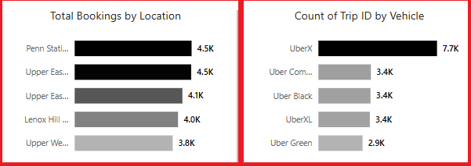
Total Bookings by Location (Top 5)
Identify the top 5 locations with the highest trip bookings.
Helps in demand forecasting and optimizing driver availability in high-traffic areas.
Most Preferred Vehicle for Location Pickup
Determine the most frequently booked vehicle type at each pickup location.
Supports strategic vehicle distribution based on customer preferences and location demand.

Slide 9
Other Implementation Enhancements for Uber Trip Analysis Dashboard
Bookmark for Data Details
Add a "Data Details" bookmark to display a pop-up or side panel explaining:
Meaning of key metrics (Total Bookings, Total Trip Distance, etc.).
Description of tables used in the analysis.
Data source and refresh frequency.
Clear Slicer Button
Add a "Clear Filters" button using a blank button with a Reset Slicers action to reset all selections in one click.
Improves user experience for quick dashboard resets.
Download Raw Data Button
Add a button to export raw data in CSV or Excel format.
Use Power Automate or built-in Power BI Export functionality.
Enables users to analyse raw data outside Power BI if needed.

Slide 10
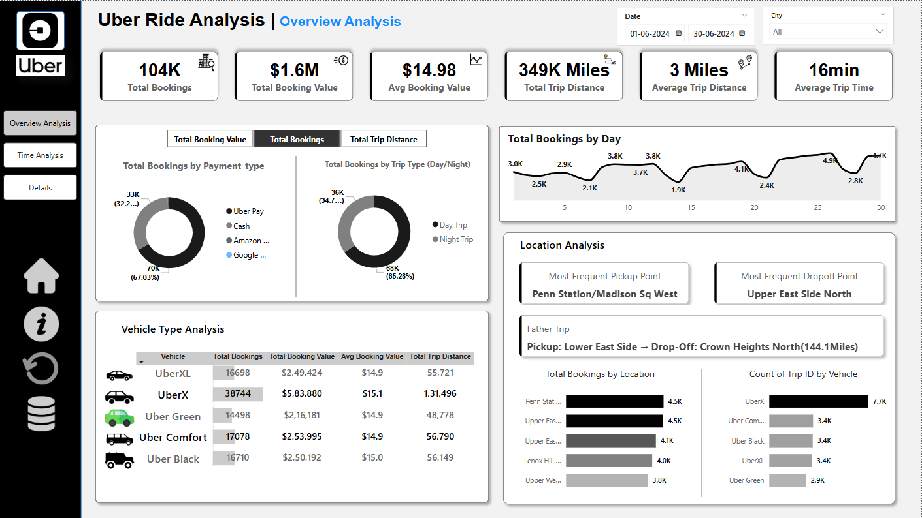
Dashboard 1 :- Overview Analysis

Slide 11
DAHBOARD 2: TIME ANALYSIS
To understand trip patterns based on time, Uber needs to analyse ride demand and trends across different time intervals. This dashboard will help in optimizing operations, pricing, and driver availability.
Global Dynamic Measure (Filters All Charts)
A measure selector will be created for: ✔ Total Bookings ✔ Total Booking Value ✔ Total Trip Distance This dynamic measure will update all visuals based on user selection.

Slide 12
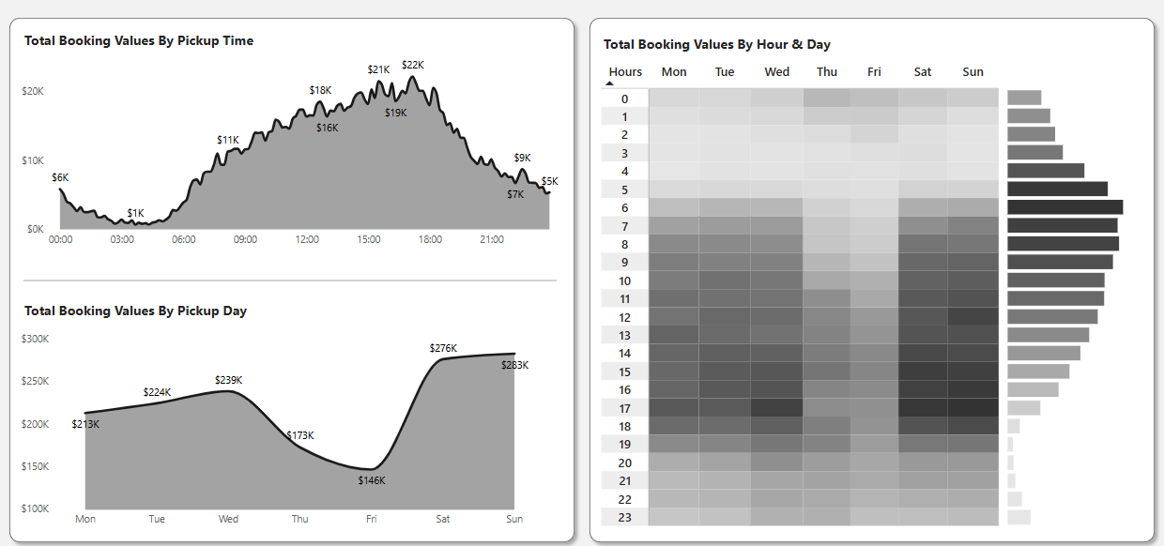
Visualizations:
By Pickup Time (10-Minute Intervals) - Area Chart
Groups trip bookings into 10-minute intervals throughout the day.
Helps in identifying peak and off-peak demand periods.
By Day Name - Line Chart
Shows booking trends across Monday to Sunday.
Useful for analysing weekday vs. weekend demand.
By Hour and Time - Heatmap (Matrix Grid)
Rows: Hours of the Day (0–23)
Columns: Days of the Week (Mon-Sun)
Values: Selected Dynamic Measure (e.g., Total Bookings)
Highlights peak booking hours across different days.

Slide 13
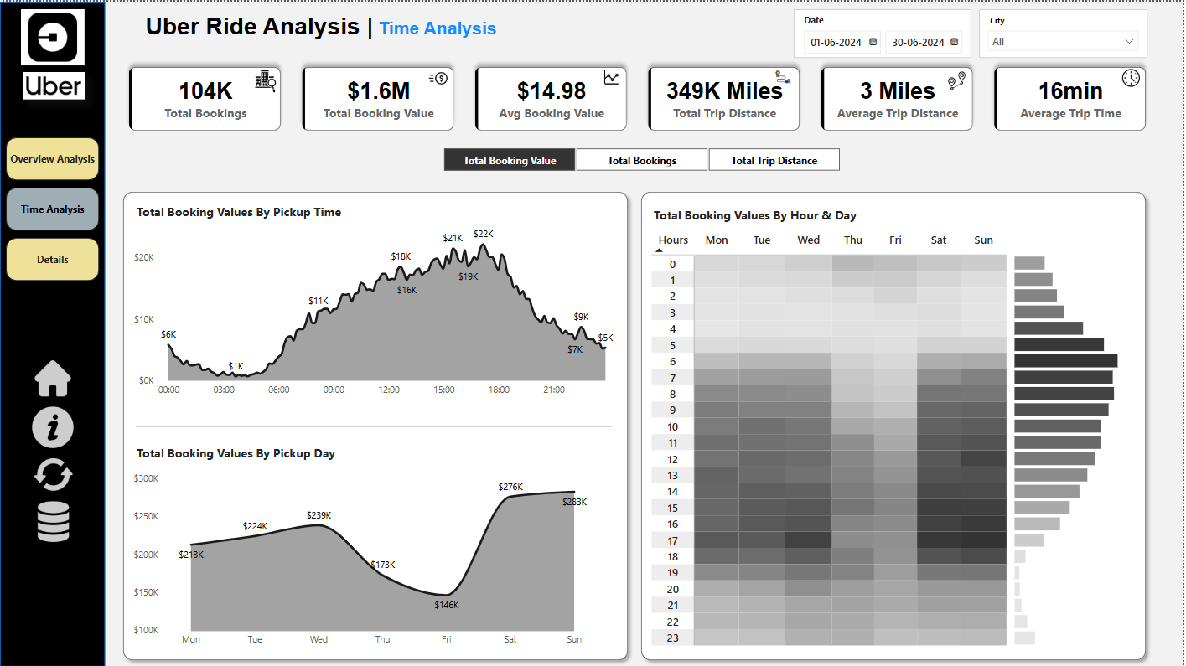
Dashboard 2 : - Time Analysis Using Power bi

Slide 14
DAHBOARD 3: DETAILS TAB
To provide in-depth insights and allow users to explore granular data, a Grid Tab will be created. This tab will enable drill-through functionality, allowing users to access detailed records based on selections made in other dashboards.
Features of the Grid Tab:
Grid Table with Key Fields:
Displays essential trip details
Drill-Through Functionality:
Users can right-click on a data point from other visuals (e.g., charts, heatmaps) and drill through to this Grid Tab.
Displays detailed records related to the selected data point.
Bookmark for Full Data View:
A "View Full Data" bookmark to toggle between filtered drill-through data and the complete dataset.
Allows users to reset filters and see all records easily.

Slide 15
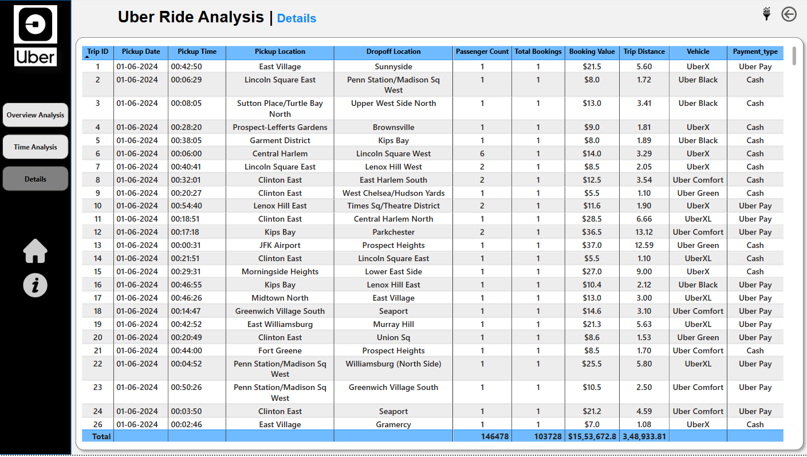
Dashboard 3 :- Detail Tab

Slide 16
Thank You
POWER BI PROJECT DATASET RESOURCE
Project Resource: -
GitHub Project Link: https://github.com/SUNIL7978/Power-Bi-Uber-Trip-Analysis
Profile Link: -
LinkedIn Profile : https://www.linkedin.com/in/sunil-kumar-prusty-5b0591343/
GitHub Profile : https://github.com/SUNIL7978
Mail Id : sunilprusty16@gmail.com
Contact : +918908676533

